Slide 1

Client Project Proposal

Slide 2

Our Client
We will be working with the New Brunswick Cultural Center
The NBCC promotes and supports art and cultural projects in New Brunswick and Middlesex County
In the past, they have promoted art and music festivals
Another major program is the NBCC’s help in raising money for food drives

Slide 3
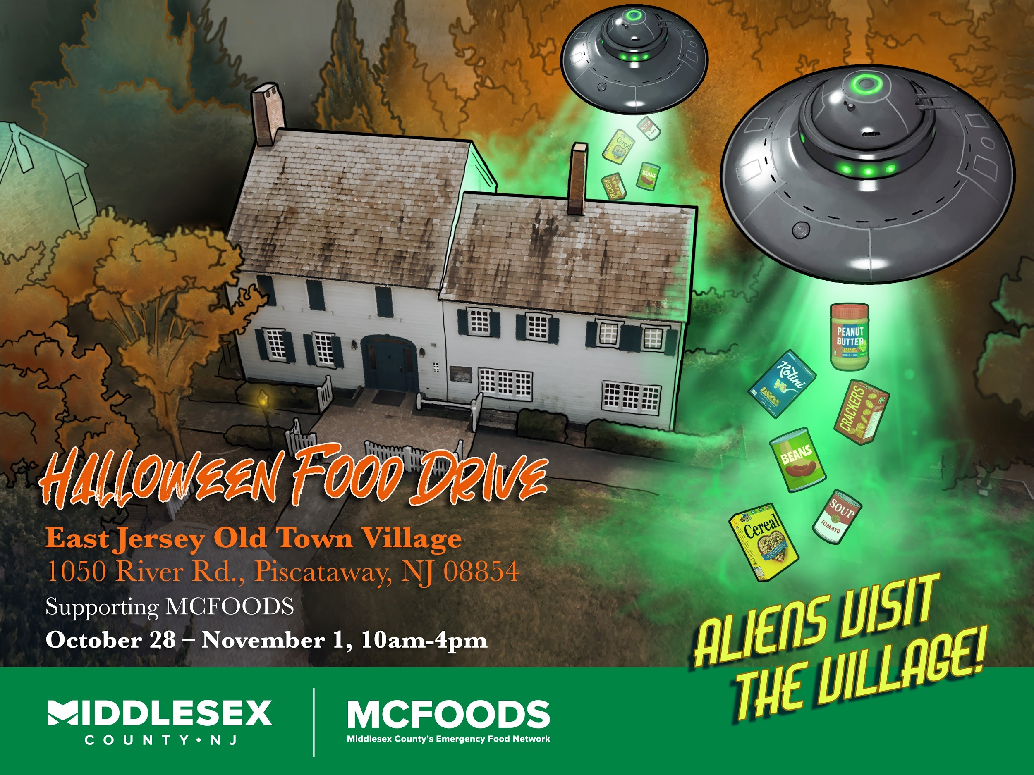
Previous Food Drive Project

Slide 4
Needs Analysis
Our goal - Promote a holiday food drive / fundraiser
Find and reach out to groups that would be interested in donating
Create an active social media presence
Help draft social media posts to promote the fundraiser and food drive
Gather content for a Middlesex County .gov webpage
Link to donate, DIY crafts, holiday playlists

Slide 5

Website content
Images and videos
DIY crafts, playlists, recipes, methods for celebrating virtually
Information about the events
Web designing ideas
Website is early-internet-esque

Slide 6
Social Media
Design posts for various social media platforms
Identify target audience
Determine how the efforts can be used for future projects
Promote spirit of giving, emphasize goodwill and charity

Slide 7
Next Steps
Discuss our findings ever week with the client
More brainstorming sessions
Discuss findings of other team members
See if any new requirements are added by the client

